Slide 1

CS552: Computer Graphics
Lecture 1: Welcome to the Course

Slide 2
People
Instructor
Chiranjoy Chattopadhyay
Teaching Assistant
Kumar Rahul (PhD, EE)

Slide 3
What is Computer Graphics?
Creation, Manipulation, and Storage of geometric objects (modelling) and their images (rendering)
Display those images on screens or hardcopy devices
Image processing
Others: GUI, Haptics, Displays (VR)...

Slide 4

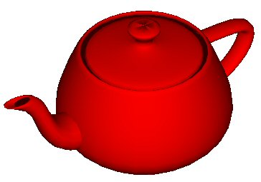
Purpose of computer graphics?
Communication is the purpose
Human perception is the context
Techniques leverage visual perception abilities
Fidelity is a tool, not (necessarily) the goal
Virtual reality is great, but
Don’t want to be limited to reality
Want to do super reality
Non-photorealistic rendering (NPR) is valuable
Bill Buxton, Sketching User Experiences, 2006
No apology is required for “approximations”
Especially for interactive graphics

Slide 5
Tentative flow of the course
Month | Topics
January | Intro to OpenGL 2D Graphics 3D Graphics Viewing Scan Conversion
February | Clipping Curves and Surfaces Tessellation
March | Solid Modeling Rendering Visible Surface Detection
April | Illumination and Shedding Animations

Slide 6
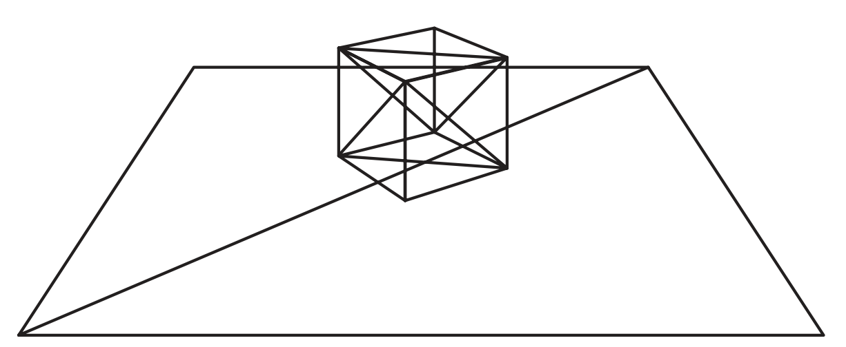
Illustration

Slide 7
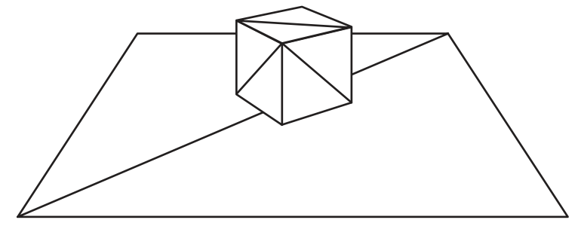
Hidden Surface Removal

Slide 8
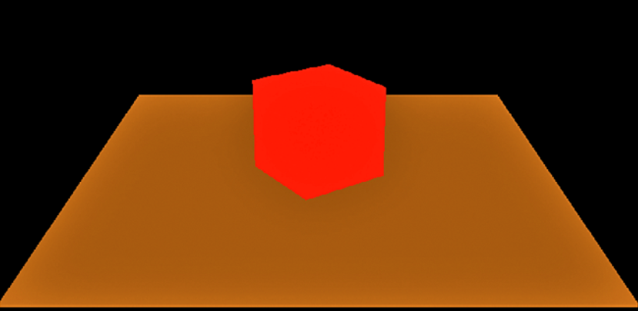
Coloring

Slide 9

Shading

Slide 10
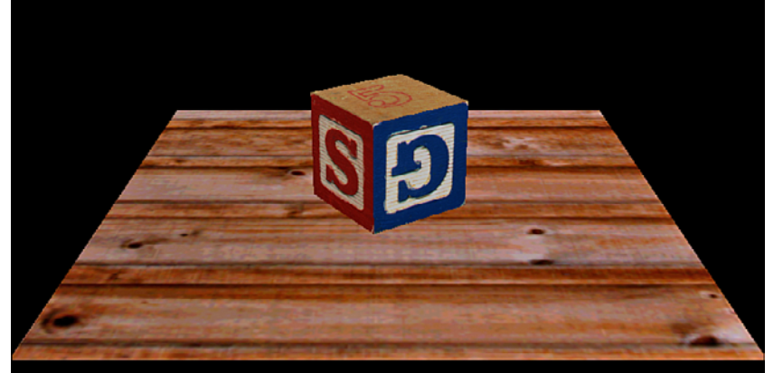
Texture Mapping

Slide 11
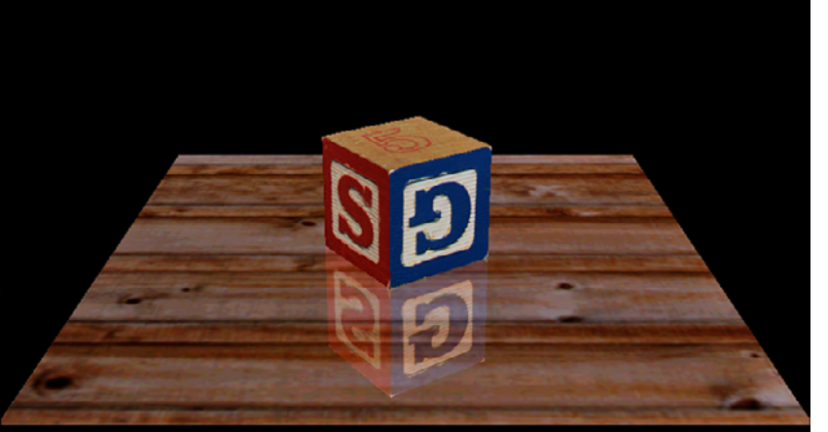
Blending

Slide 12
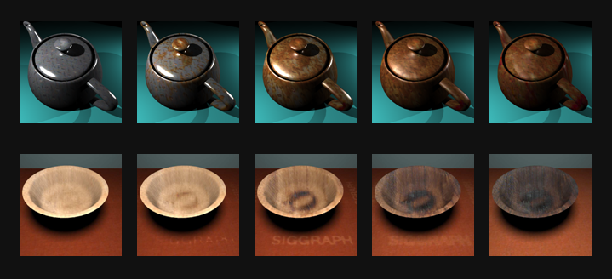
Rendering example
Time-varying Surface Appearance: Acquisition, Modeling, and Rendering, SIGGRAPH 2006

Slide 13
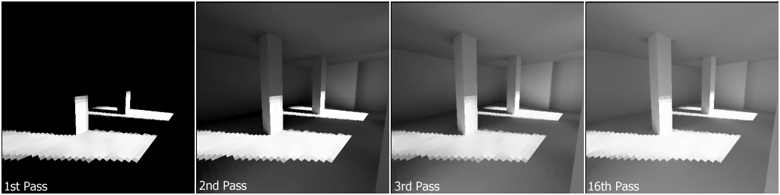
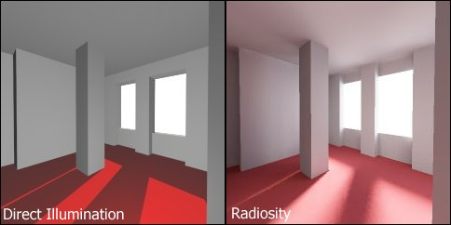
Realistic rendering

Slide 14
Workload
Work load will be on the higher side
Home assignments (numerical problems)
Programming assignments (OpenGL)
Term Project (group/ individual)
Report
Code
Presentation
Viva
Potential publication

Slide 15
Evaluation pattern
Different components to be considered for final grading
End semester
Mid semester 1
Mid semester 2
Home Assignment
Term Project
Quiz
Weightage for individual components TBA

Slide 16
Term project Assignment (TPA)
A set of TPAs will be announced
Students can form a group of maximum two (2) members
Grading will be done based on the performance of the individual member, not on the basis of the group
There will be a mid-term evaluation of the TPA

Slide 17
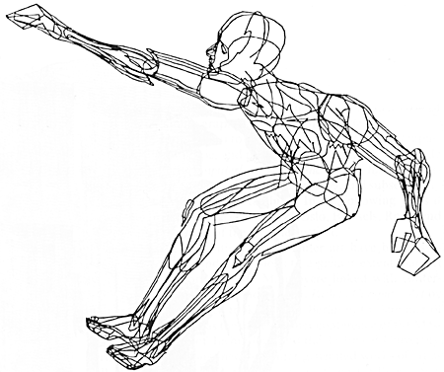
What is CG? (1/2)
Term coined in 1960, by William Fetter
To describe new design methods he was pursuing at Boeing for cockpit ergonomics
Created a series of widely reproduced images on “pen plotter” exploring cockpit design, using 3D model of human body.

Slide 18
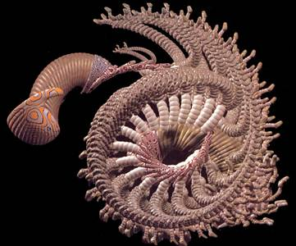
What is CG? (2/2)
Creation, storage and manipulation of models and images
Such models come from
Diverse and expanding set of fields
E.g. physical, biological, mathematical, artistic, and conceptual/abstract structures
Frame from animation by William Latham, shown at SIGGRAPH 1992. Latham creates his artwork using rules that govern patterns of natural forms.

Slide 19
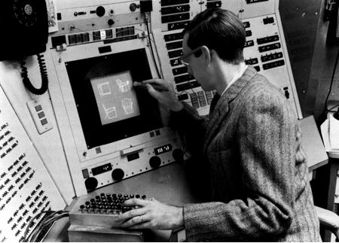
What is Interactive Computer Graphics?
User controls content, structure, and appearance of objects and their displayed images via rapid visual feedback
Input
Processing
Display
Storage
First truly interactive graphics system, Sketchpad, pioneered by Ivan Sutherland 1963 Ph.D. thesis Sketchpad, A Man-Machine Graphical Communication System

Slide 20
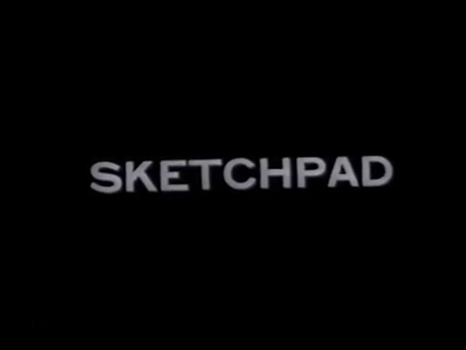
Sketchpad Demo

Slide 21
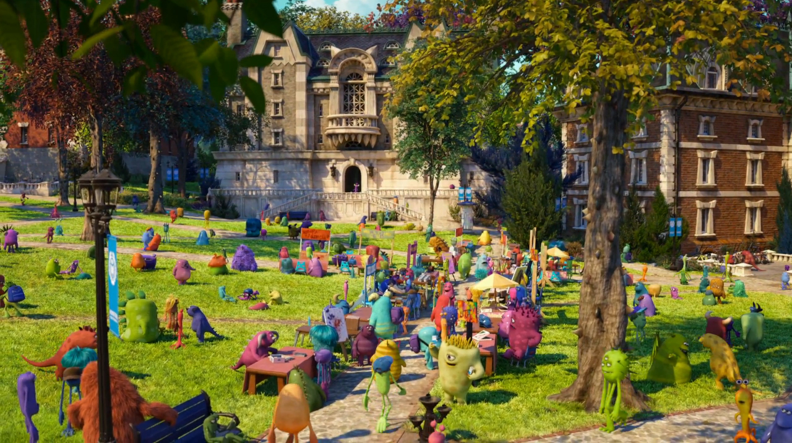
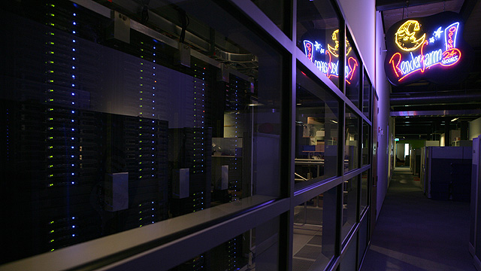
What is Batch Computer Graphics?
Today, still use non-interactive batch mode for final production-quality video and film (special effects – FX).
Rendering a single frame of Monsters University (a 24 fps movie) averaged 29 hours on a 24,000-core render farm!
Still from Monsters University
Render farm

Slide 22
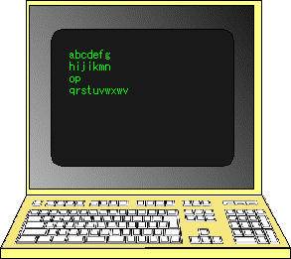
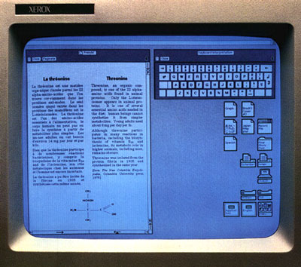
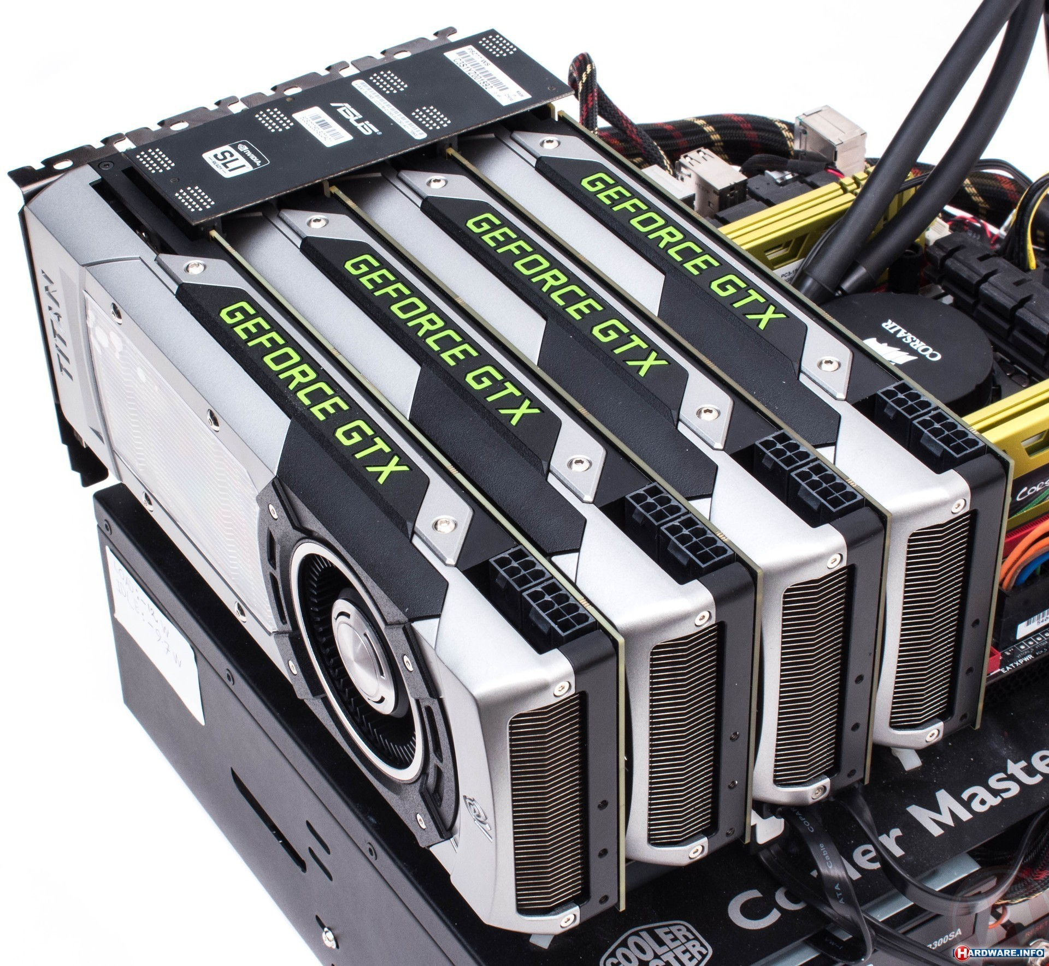
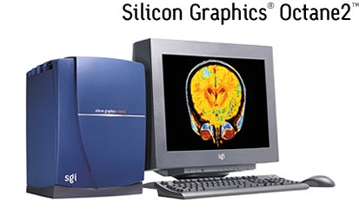
Environmental evolution
(1960s – now)
Displays (1963 – 1980s)
(1972 at Xerox PARC - now)
3D graphics workstations (1984 at SGI – now)
You can put multiple GPUs together in your computer using SLI.

Slide 23
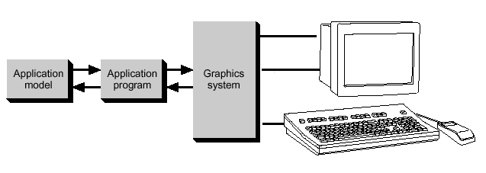
Conceptual Framework
Graphics library/package is intermediary between application and display hardware (Graphics System)
Application program maps application objects to views (images) of those objects by calling on graphics library. Application model may contain lots of non-graphical data (e.g., non-geometric object properties)
User interaction results in modification of image and/or model
This hardware and software framework is 5 decades old but is still useful
Software
Hardware
Graphics
System/
GPU
Graphics
Library
Application
program
Application
Model / database

Slide 24





Graphics Library
Examples: OpenGL™, DirectX™, Windows Presentation Foundation™ (WPF), RenderMan™, HTML5 + WebGL™
Primitives (characters, lines, polygons, meshes,…)
Attributes
Color, line style, material properties for 3D
Lights
Transformations
Immediate mode vs. retained mode
Immediate mode: no stored representation, package holds only attribute state, and application must completely draw each frame
Retained mode: library compiles and displays from scenegraph that it maintains, a complex DAG. It is a display-centered extract of the Application Model

Slide 25
Who should take the course?
Students with strong base in programming, specifically C++
Having a knowledge of software engineering skills will be added advantage
Keen on doing mathematical calculation
Good at linear algebra (vector and matrix arithmetic, dot and cross products)
Self motivated

Slide 26
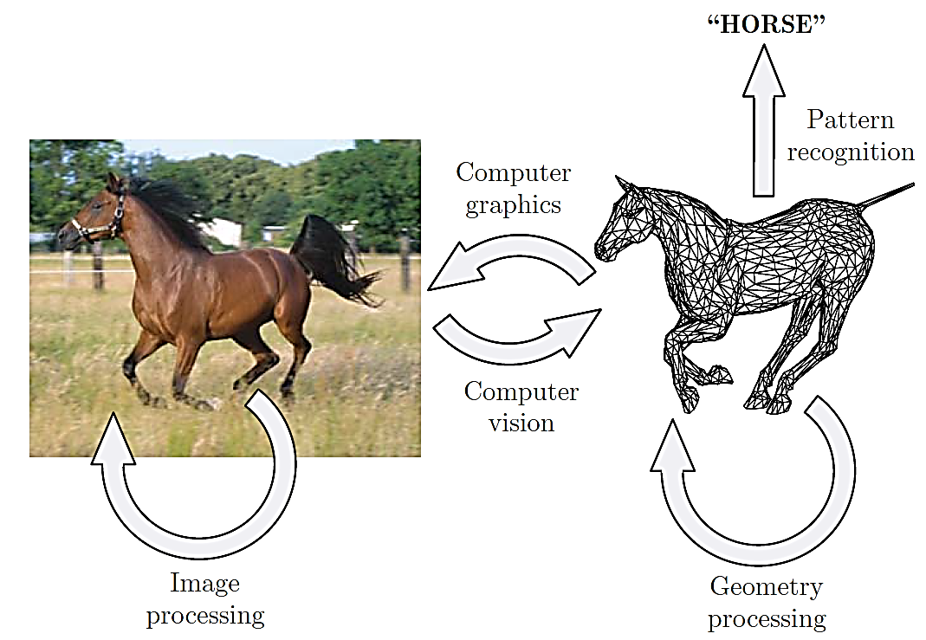
Some related field

Slide 27
Thank you
Next Lecture: Introduction to OpenGL

